Slide 1
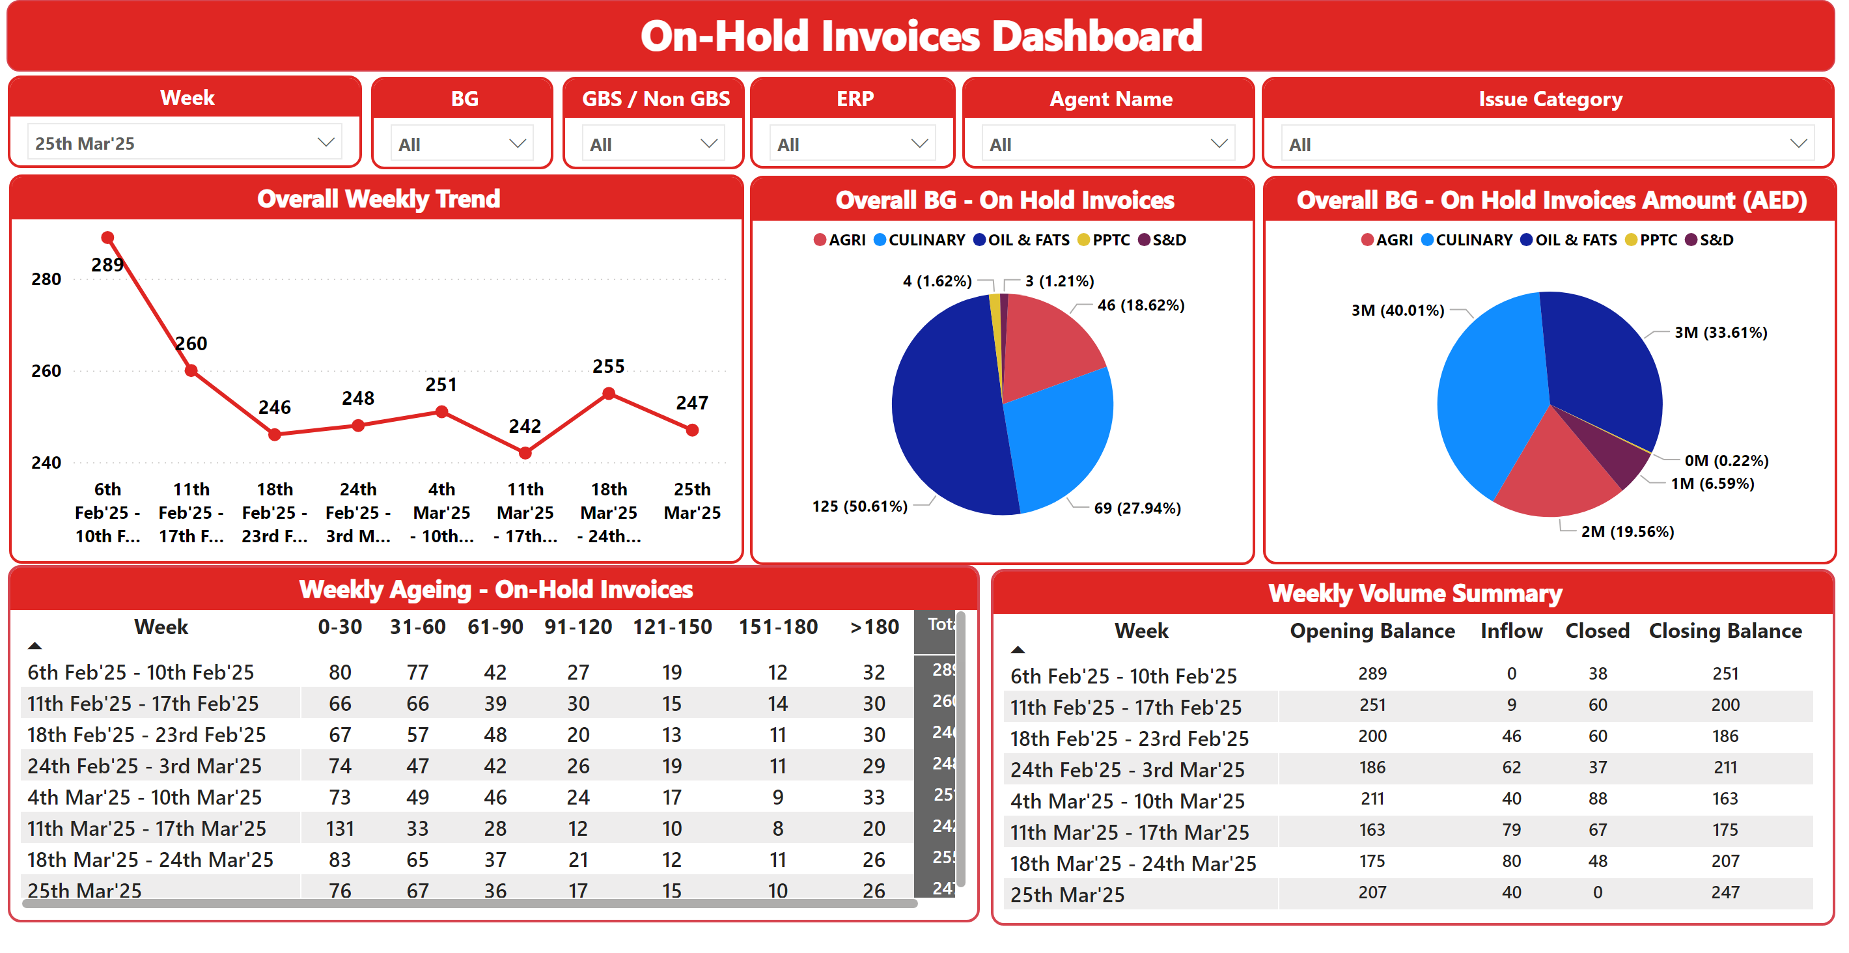
Overall Summary
Notes:
Overall Weekly Trend
No alt text provided
On-Hold Invoices Dashboard
No alt text provided
Weekly Ageing - On-Hold Invoices
No alt text provided
BG
No alt text provided
Week
No alt text provided
GBS / Non GBS
No alt text provided
ERP
No alt text provided
Issue Category
No alt text provided
Agent Name
No alt text provided
Overall BG - On Hold Invoices
No alt text provided
Weekly Volume Summary
No alt text provided
Overall BG - On Hold Invoices Amount (AED)
No alt text provided

Slide 2
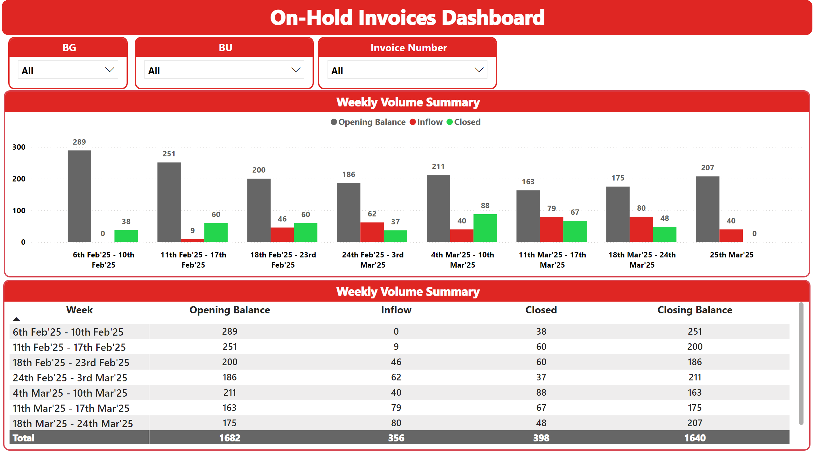
Weekly Volumes
Notes:
On-Hold Invoices Dashboard
No alt text provided
BG
No alt text provided
Weekly Volume Summary
No alt text provided
Weekly Volume Summary
No alt text provided
BU
No alt text provided
Invoice Number
No alt text provided

Slide 3
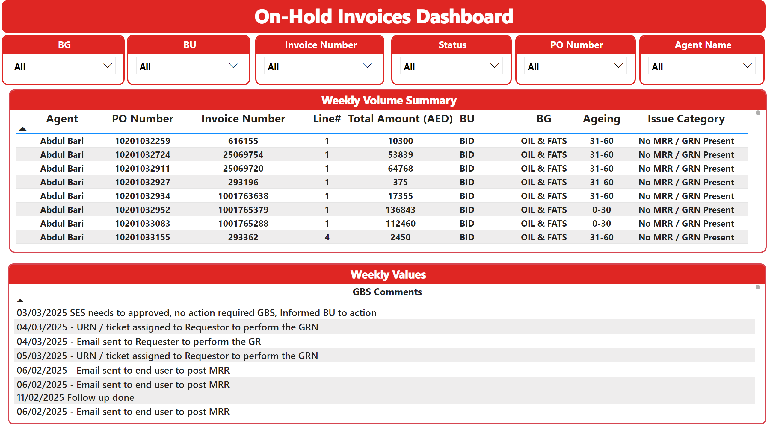
GBS Comments
Notes:
On-Hold Invoices Dashboard
No alt text provided
BG
No alt text provided
BU
No alt text provided
Weekly Values
No alt text provided
Invoice Number
No alt text provided
Status
No alt text provided
PO Number
No alt text provided
Weekly Volume Summary
No alt text provided
Agent Name
No alt text provided

Slide 4
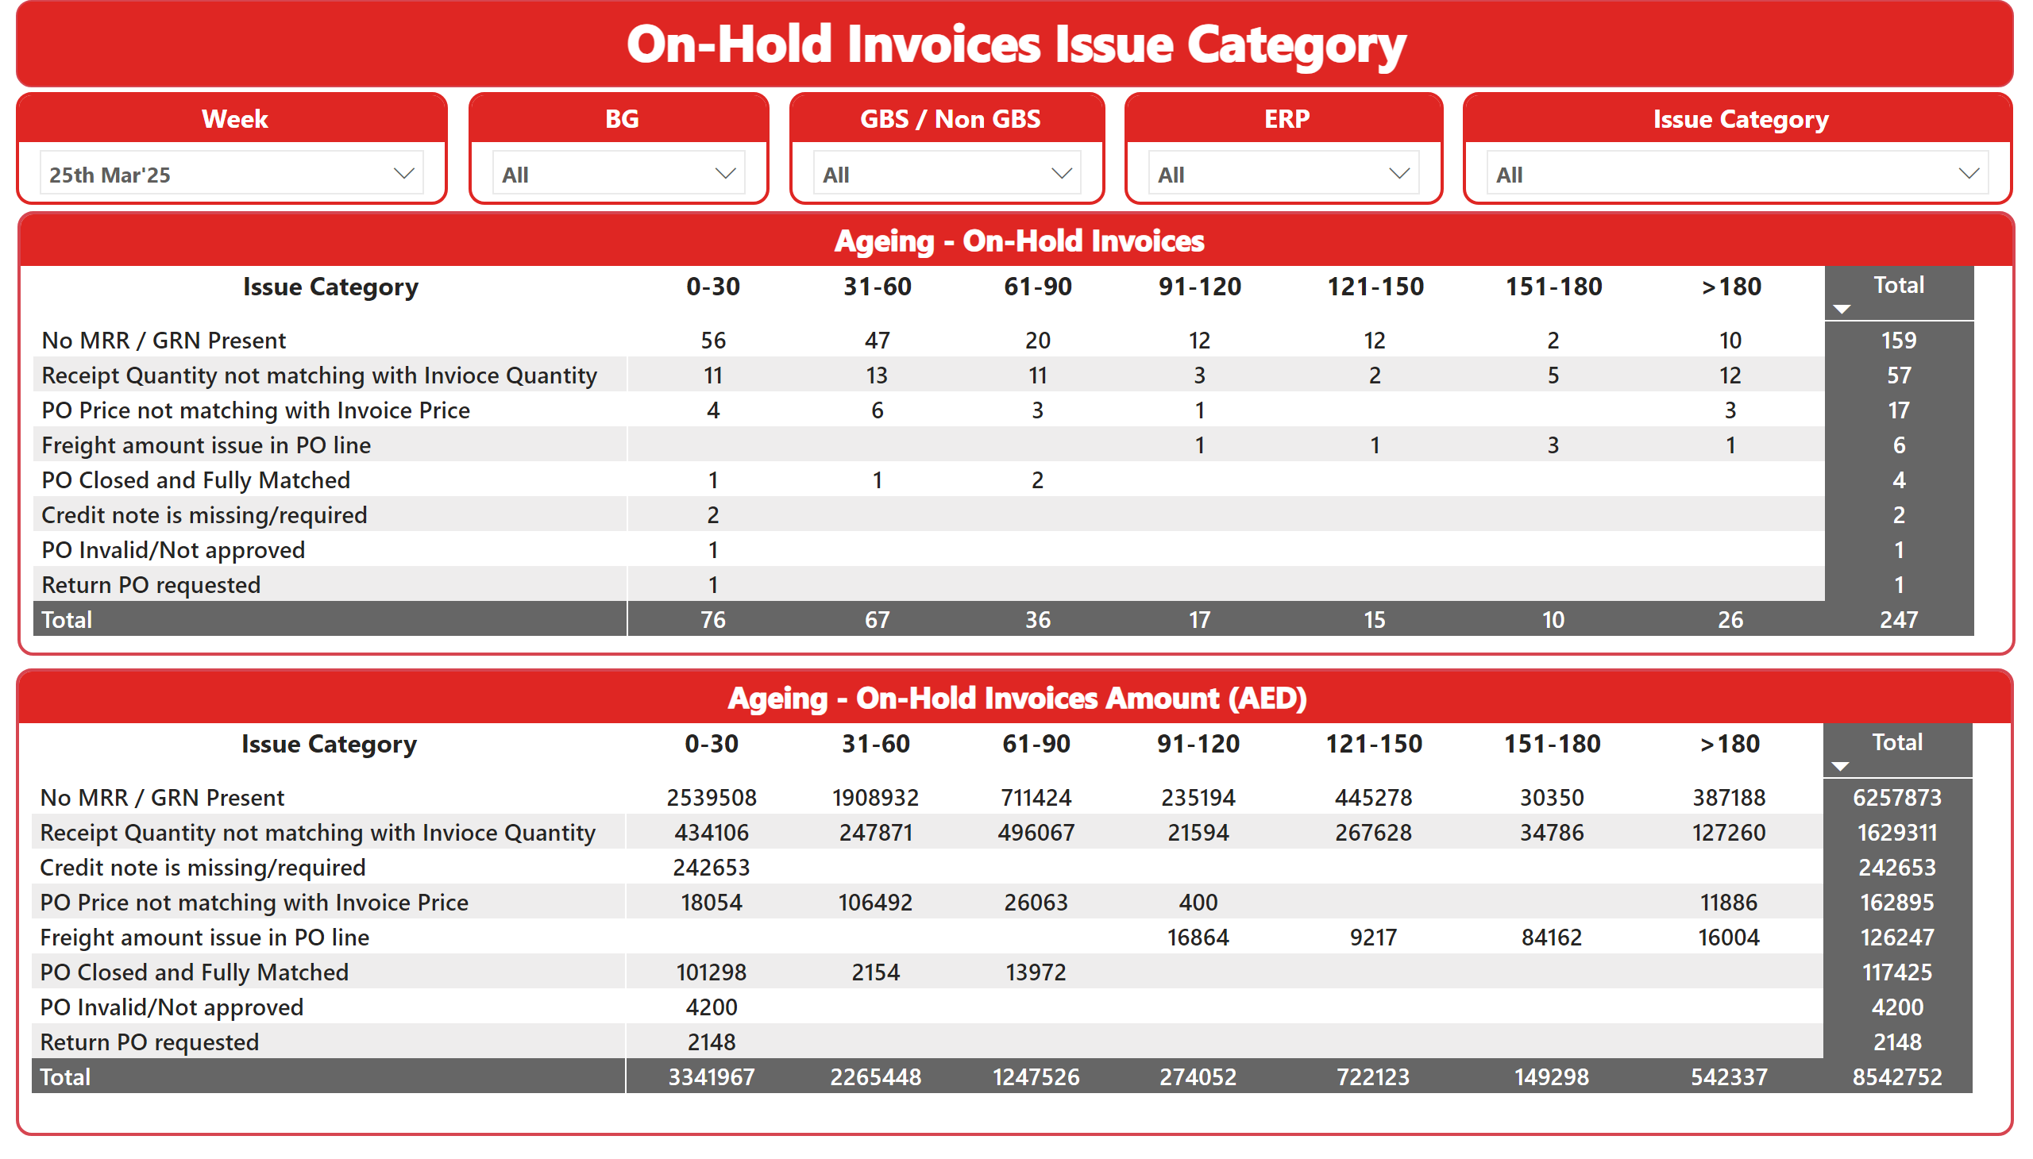
Issue Category
Notes:
On-Hold Invoices Issue Category
No alt text provided
Ageing - On-Hold Invoices Amount (AED)
No alt text provided
BG
No alt text provided
Week
No alt text provided
GBS / Non GBS
No alt text provided
ERP
No alt text provided
Issue Category
No alt text provided
Ageing - On-Hold Invoices
No alt text provided

Slide 5
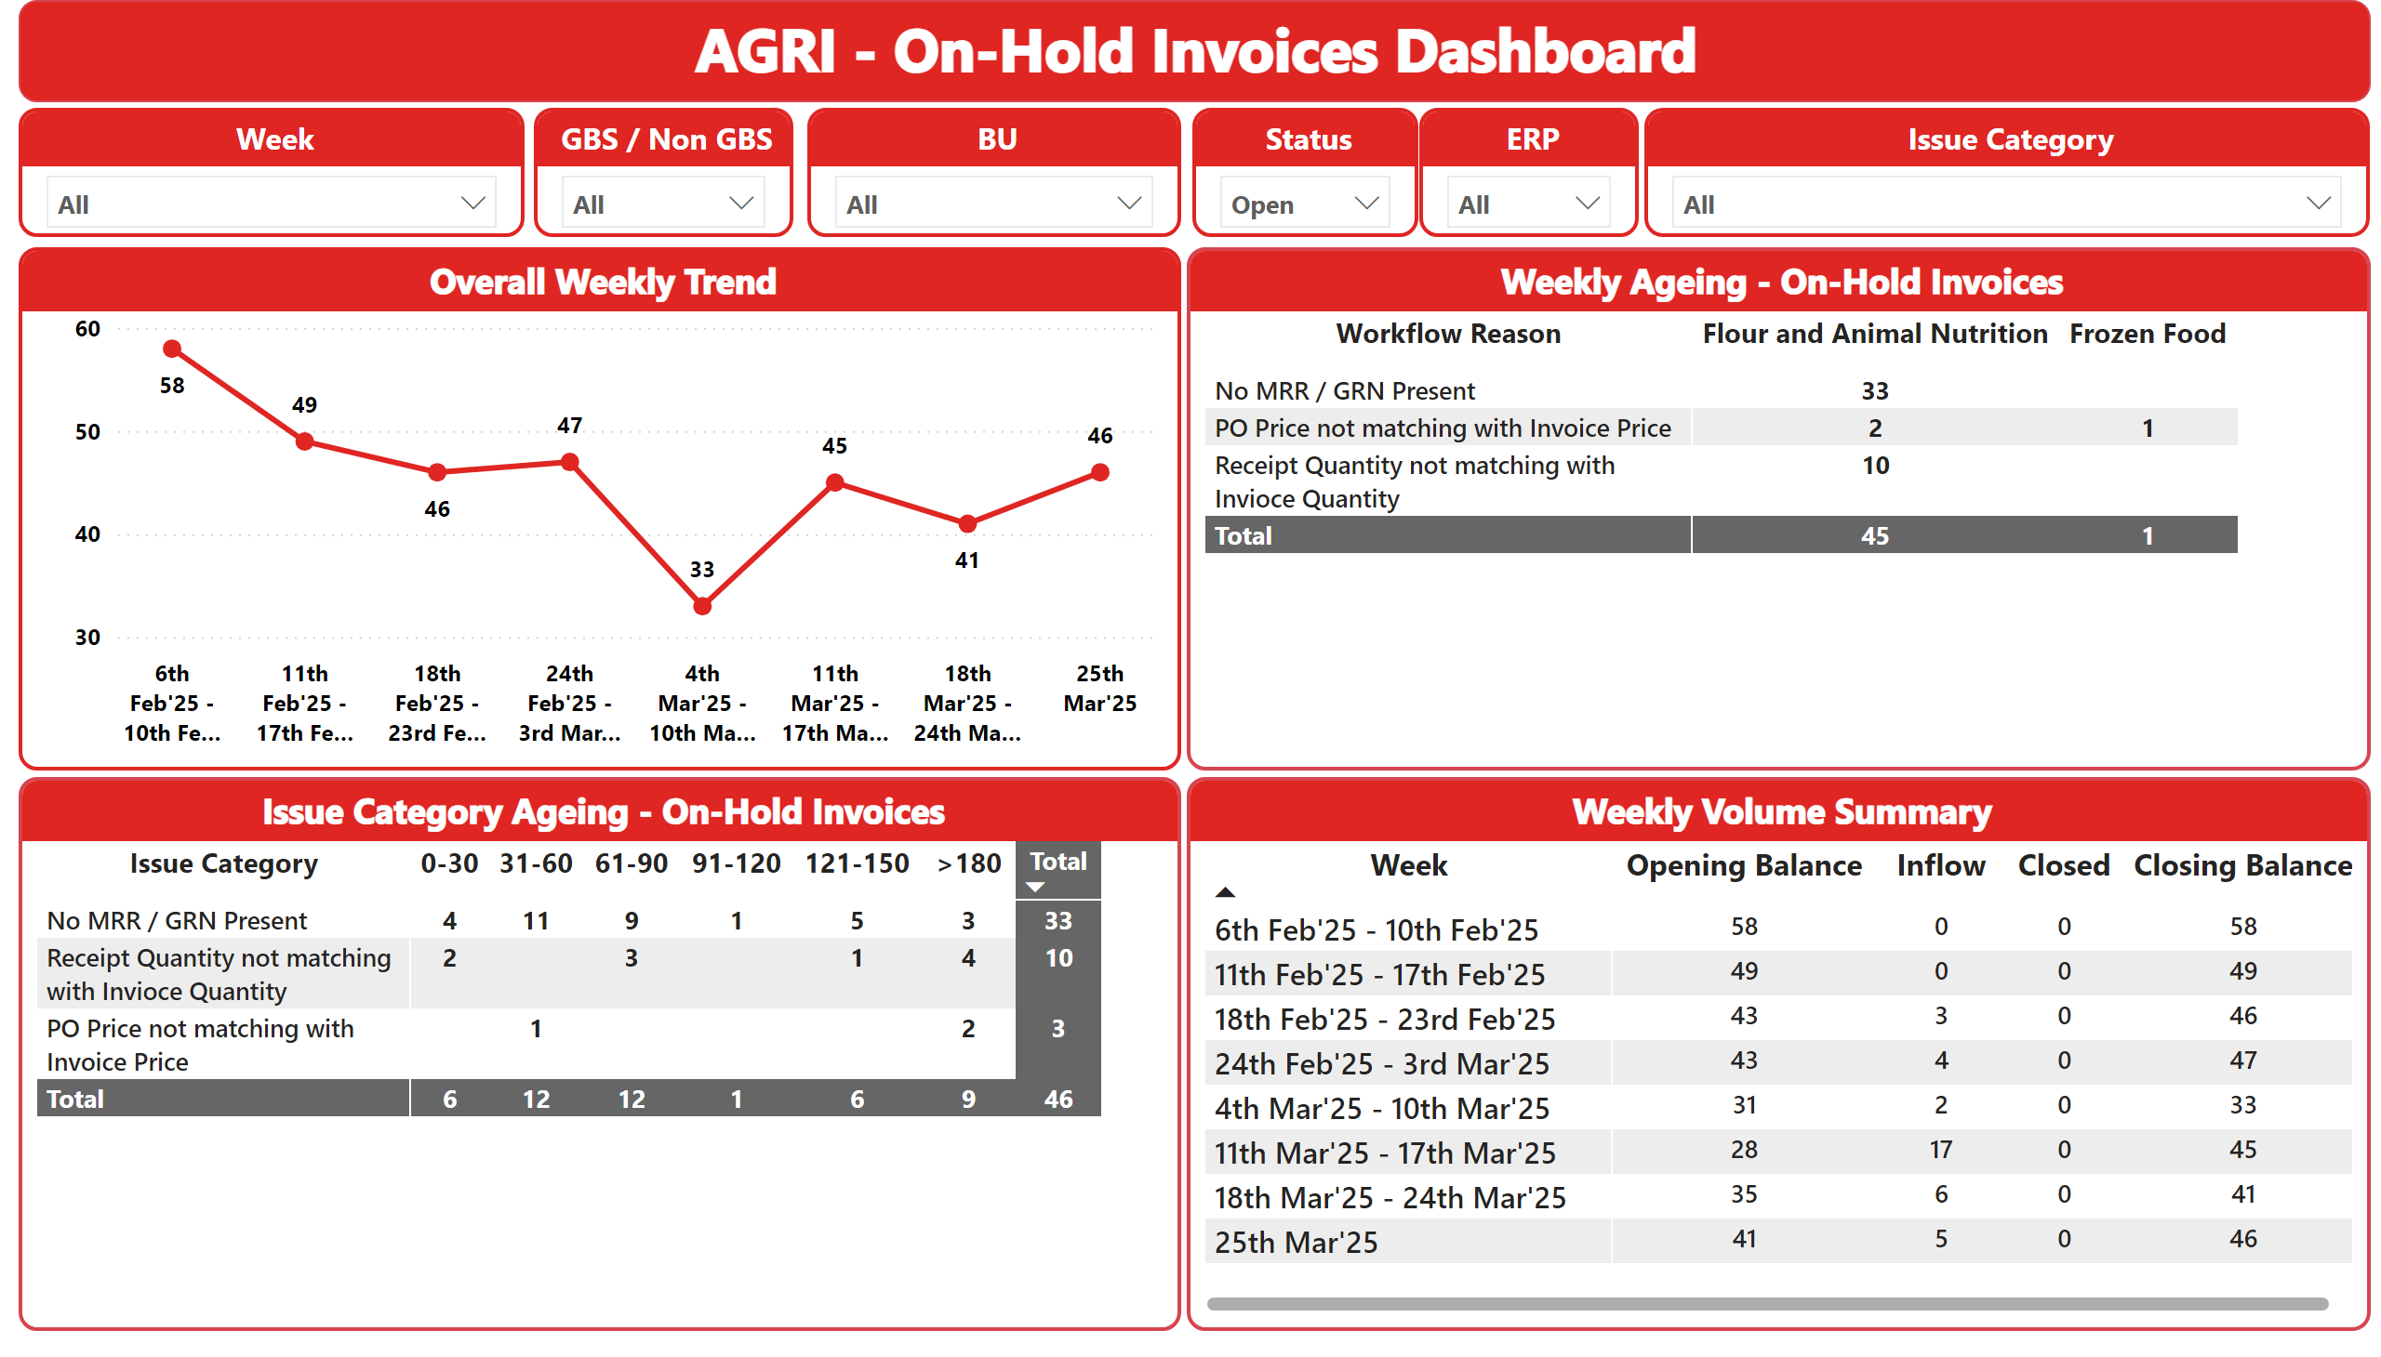
AGRI
Notes:
Overall Weekly Trend
No alt text provided
AGRI - On-Hold Invoices Dashboard
No alt text provided
Week
No alt text provided
GBS / Non GBS
No alt text provided
ERP
No alt text provided
Issue Category
No alt text provided
Issue Category Ageing - On-Hold Invoices
No alt text provided
Status
No alt text provided
BU
No alt text provided
Weekly Ageing - On-Hold Invoices
No alt text provided
Weekly Volume Summary
No alt text provided

Slide 6
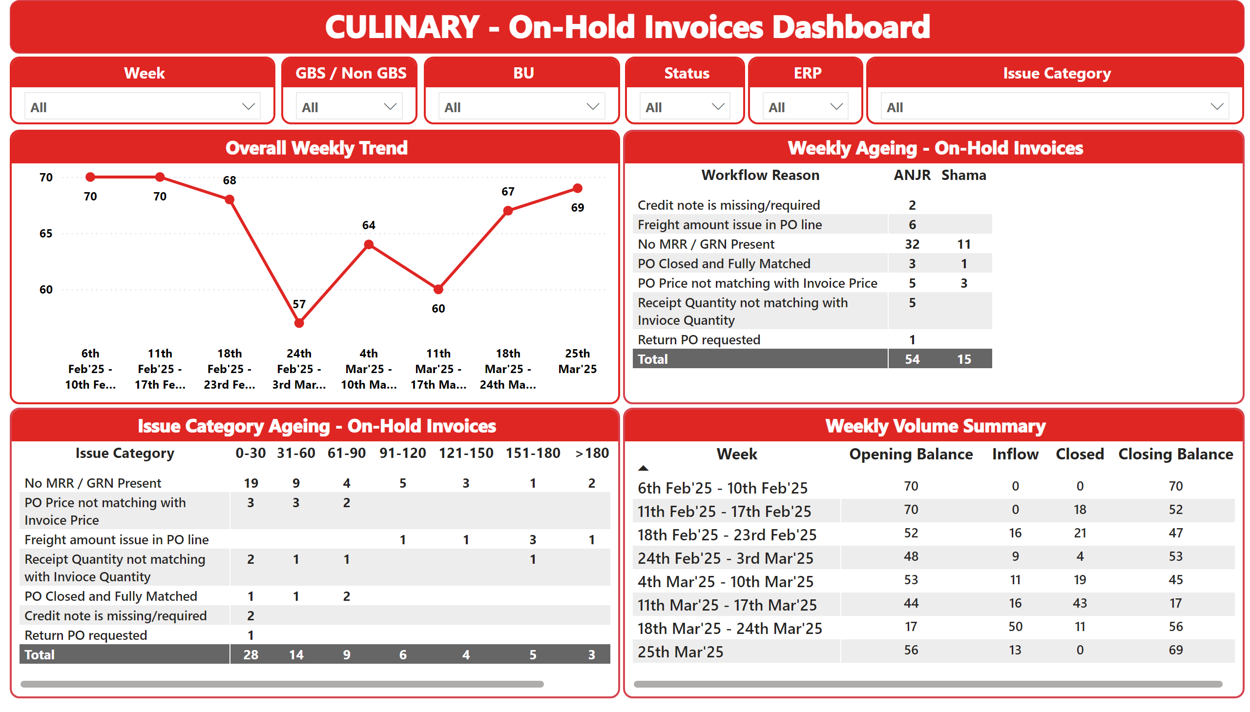
CULINARY
Notes:
Overall Weekly Trend
No alt text provided
CULINARY - On-Hold Invoices Dashboard
No alt text provided
Week
No alt text provided
GBS / Non GBS
No alt text provided
ERP
No alt text provided
Issue Category
No alt text provided
Issue Category Ageing - On-Hold Invoices
No alt text provided
Status
No alt text provided
BU
No alt text provided
Weekly Ageing - On-Hold Invoices
No alt text provided
Weekly Volume Summary
No alt text provided

Slide 7
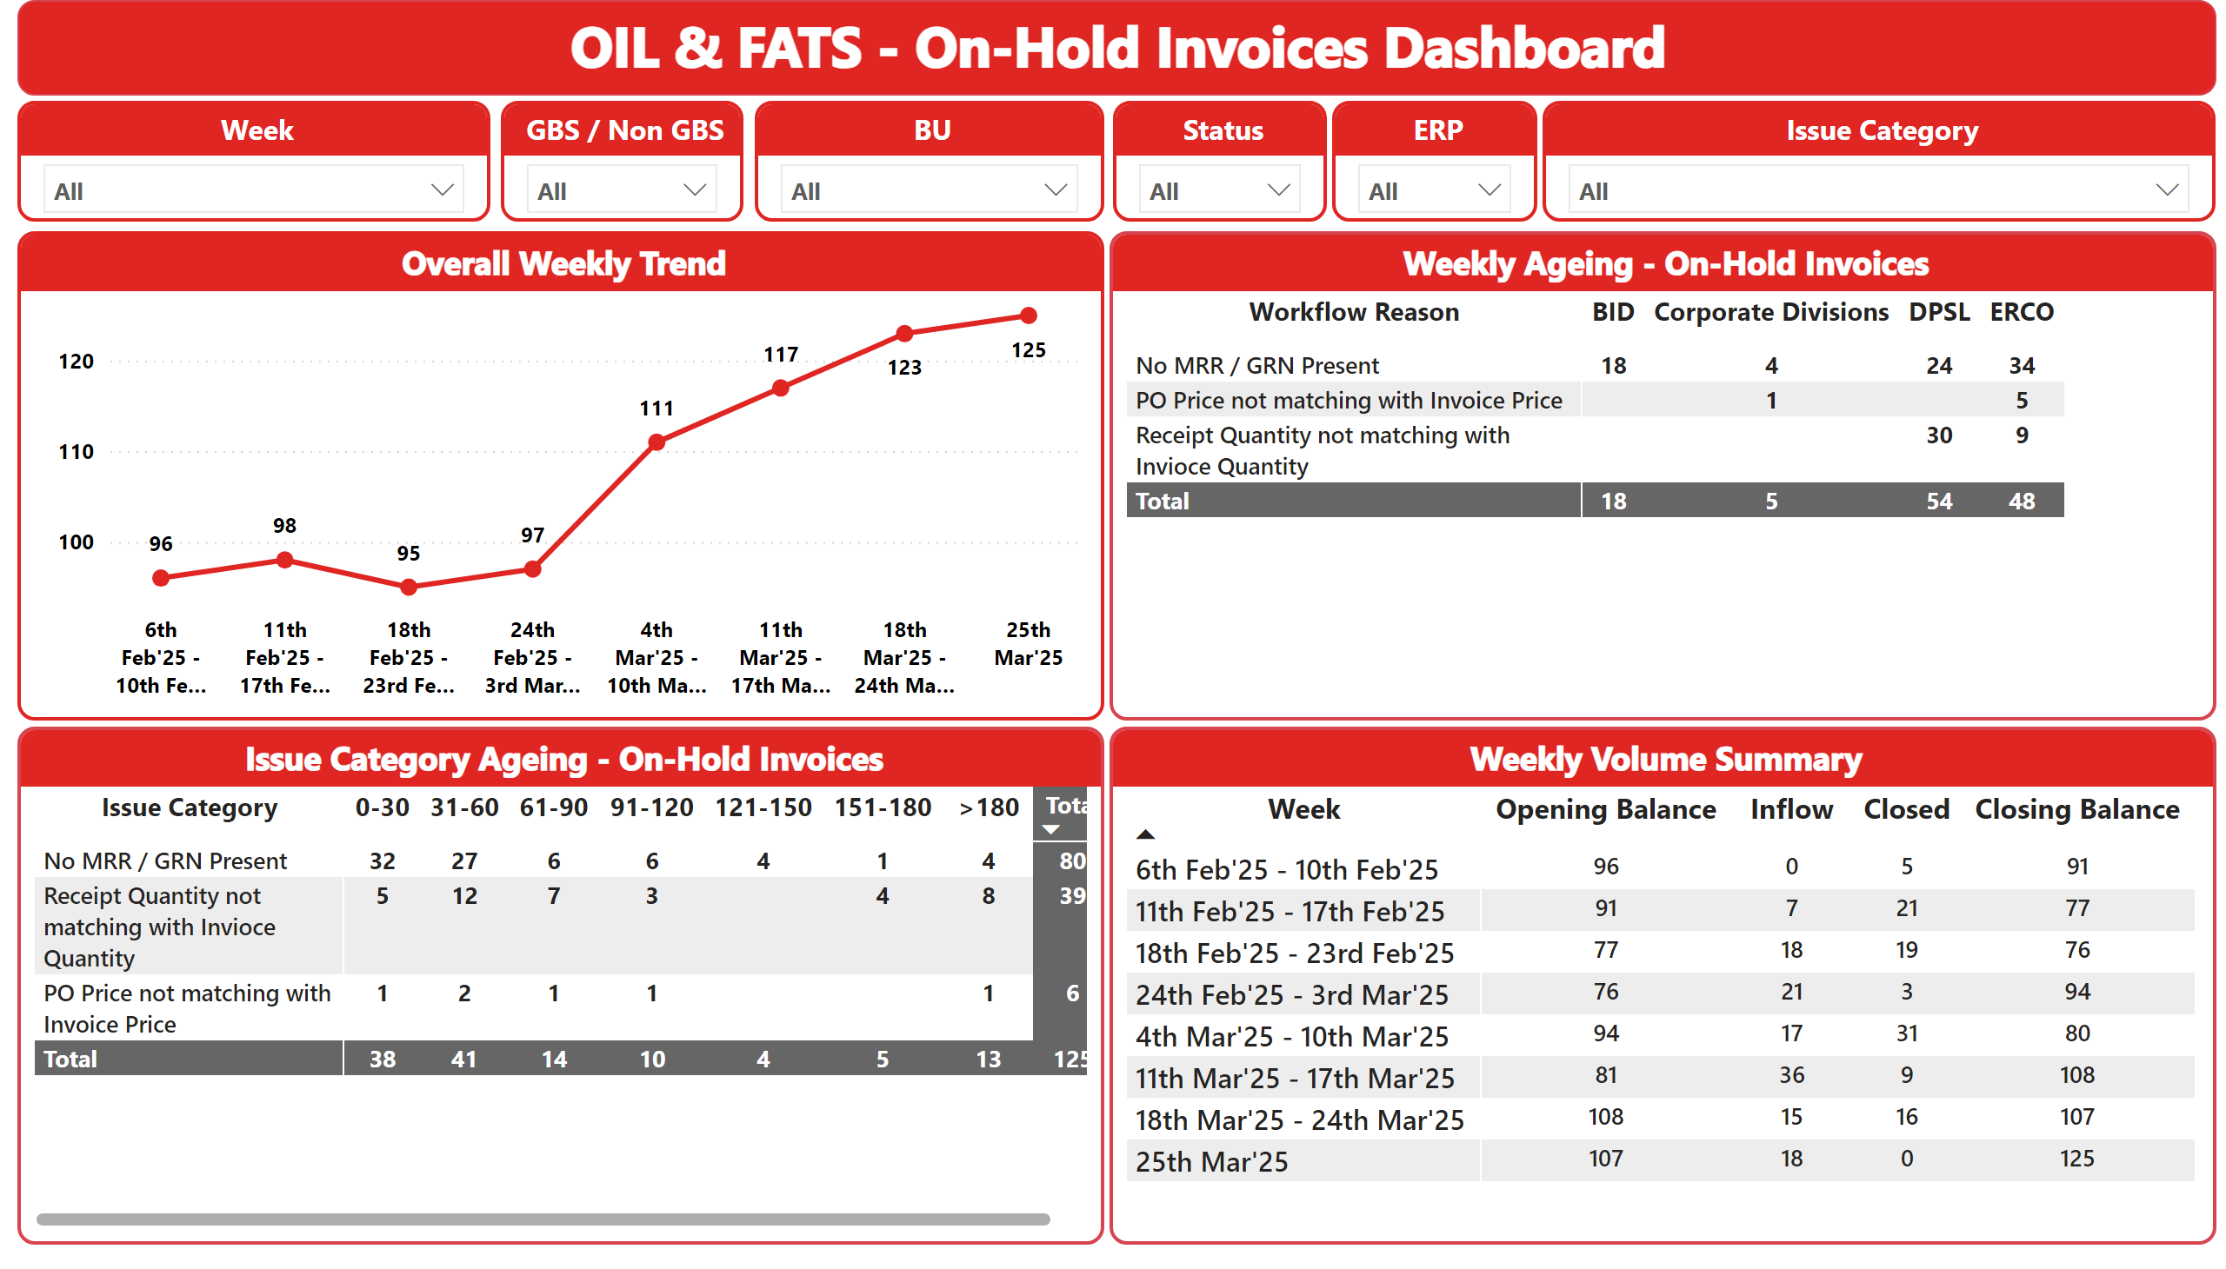
OIL & FATS
Notes:
Overall Weekly Trend
No alt text provided
OIL & FATS - On-Hold Invoices Dashboard
No alt text provided
Week
No alt text provided
GBS / Non GBS
No alt text provided
ERP
No alt text provided
Issue Category
No alt text provided
Issue Category Ageing - On-Hold Invoices
No alt text provided
Status
No alt text provided
BU
No alt text provided
Weekly Ageing - On-Hold Invoices
No alt text provided
Weekly Volume Summary
No alt text provided

Slide 8
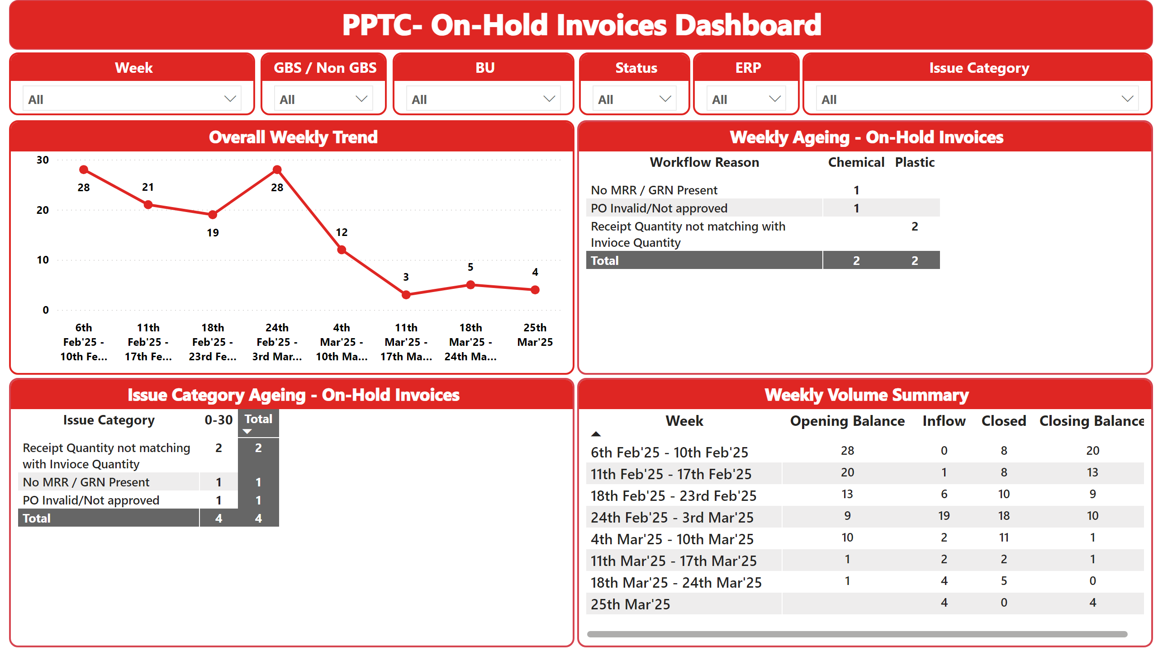
PPTC
Notes:
Overall Weekly Trend
No alt text provided
PPTC- On-Hold Invoices Dashboard
No alt text provided
Week
No alt text provided
GBS / Non GBS
No alt text provided
ERP
No alt text provided
Issue Category
No alt text provided
Issue Category Ageing - On-Hold Invoices
No alt text provided
Status
No alt text provided
BU
No alt text provided
Weekly Ageing - On-Hold Invoices
No alt text provided
Weekly Volume Summary
No alt text provided

Slide 9
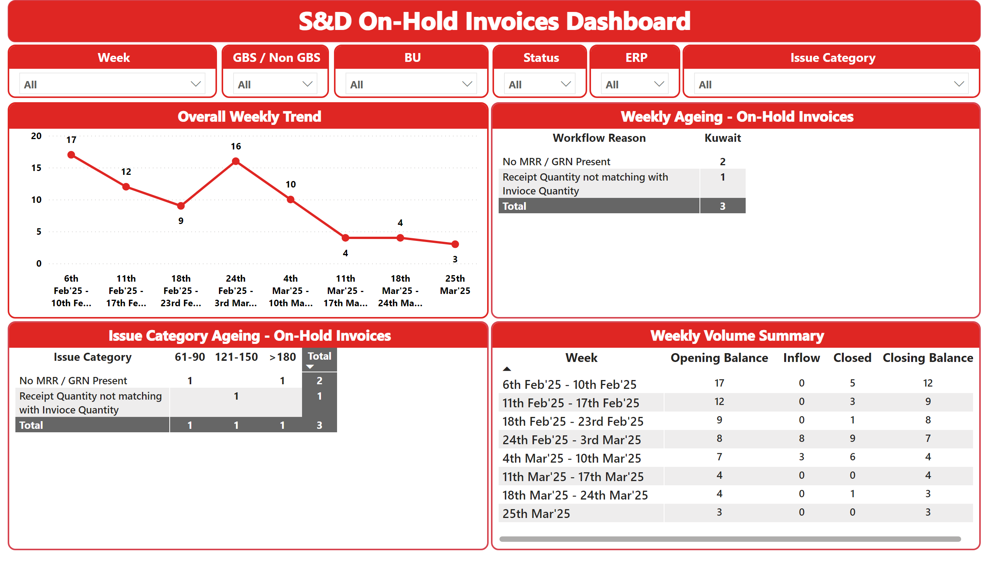
S&D
Notes:
Overall Weekly Trend
No alt text provided
S&D On-Hold Invoices Dashboard
No alt text provided
Week
No alt text provided
GBS / Non GBS
No alt text provided
ERP
No alt text provided
Issue Category
No alt text provided
Issue Category Ageing - On-Hold Invoices
No alt text provided
Status
No alt text provided
BU
No alt text provided
Weekly Ageing - On-Hold Invoices
No alt text provided
Weekly Volume Summary
No alt text provided

